Slide 1
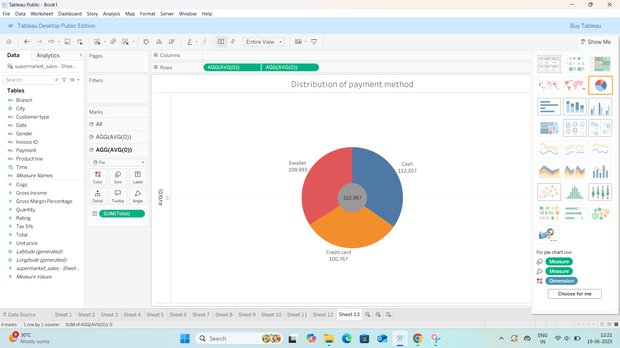
Assignment:-2 1.Donut chart:-

Slide 2
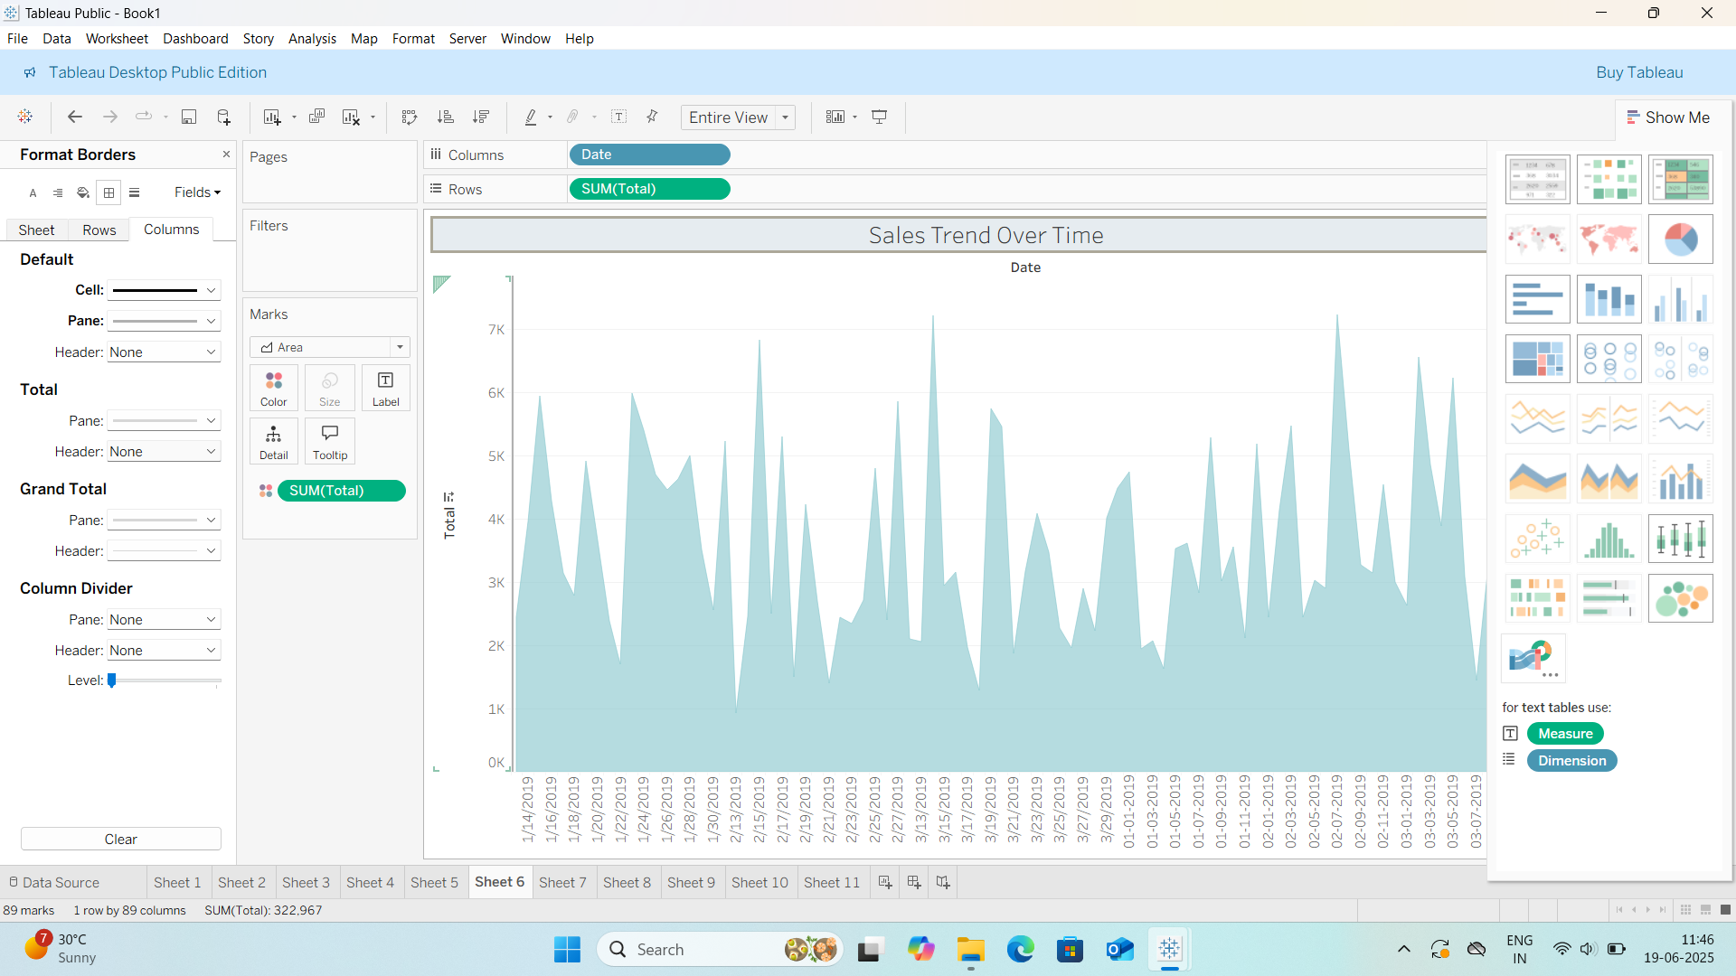
2.Area chart:-

Slide 3
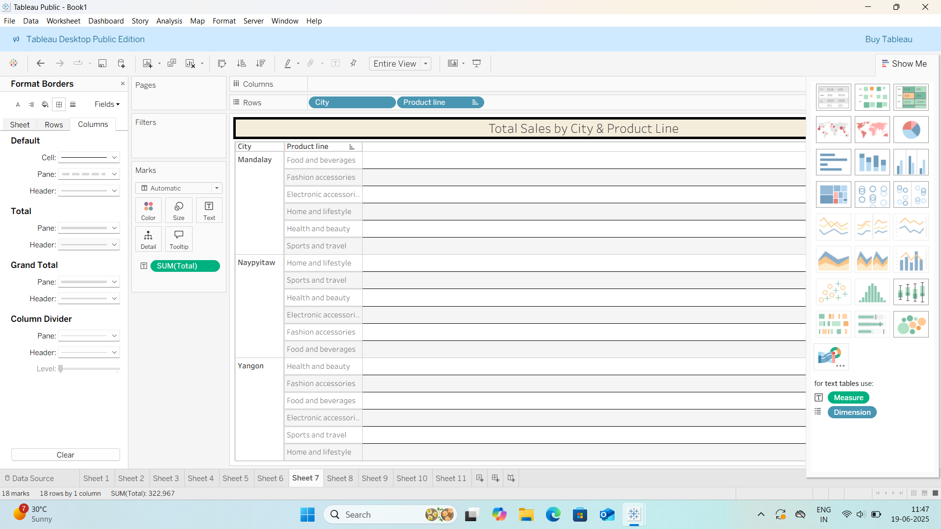
3.Text table:-

Slide 4
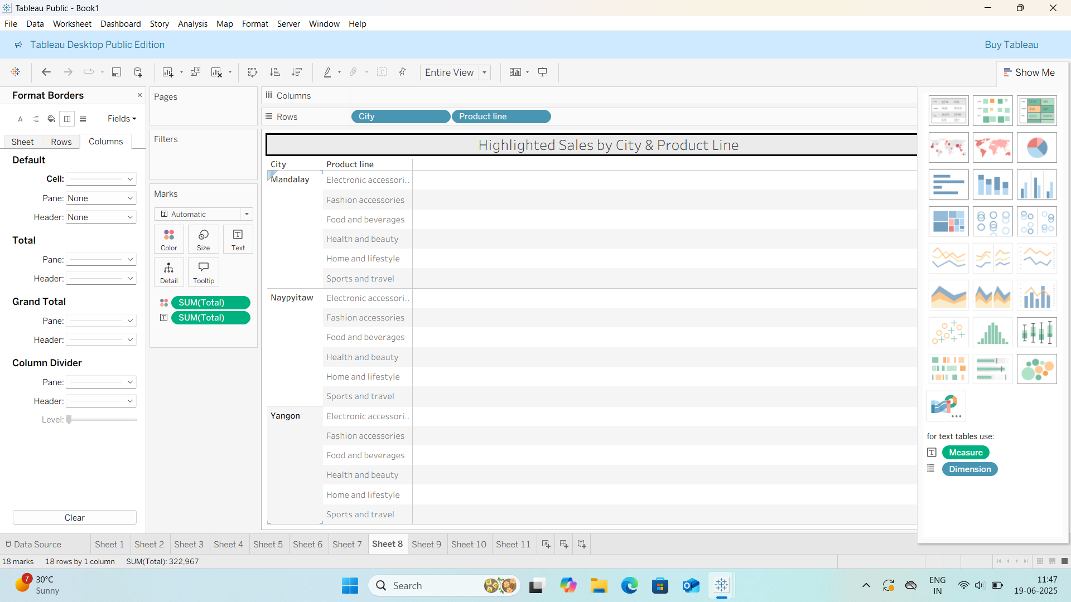
4.Highlighted Table:-

Slide 5
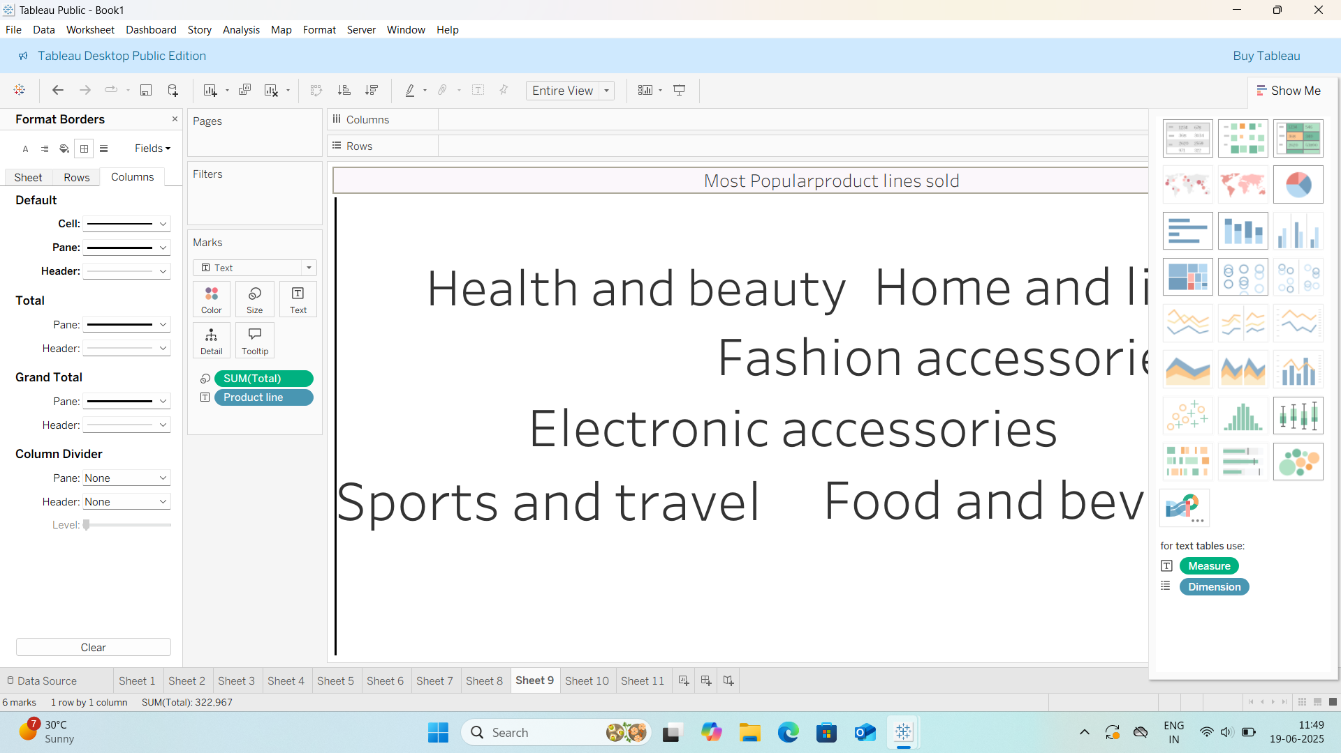
5.Word cloud:-

Slide 6
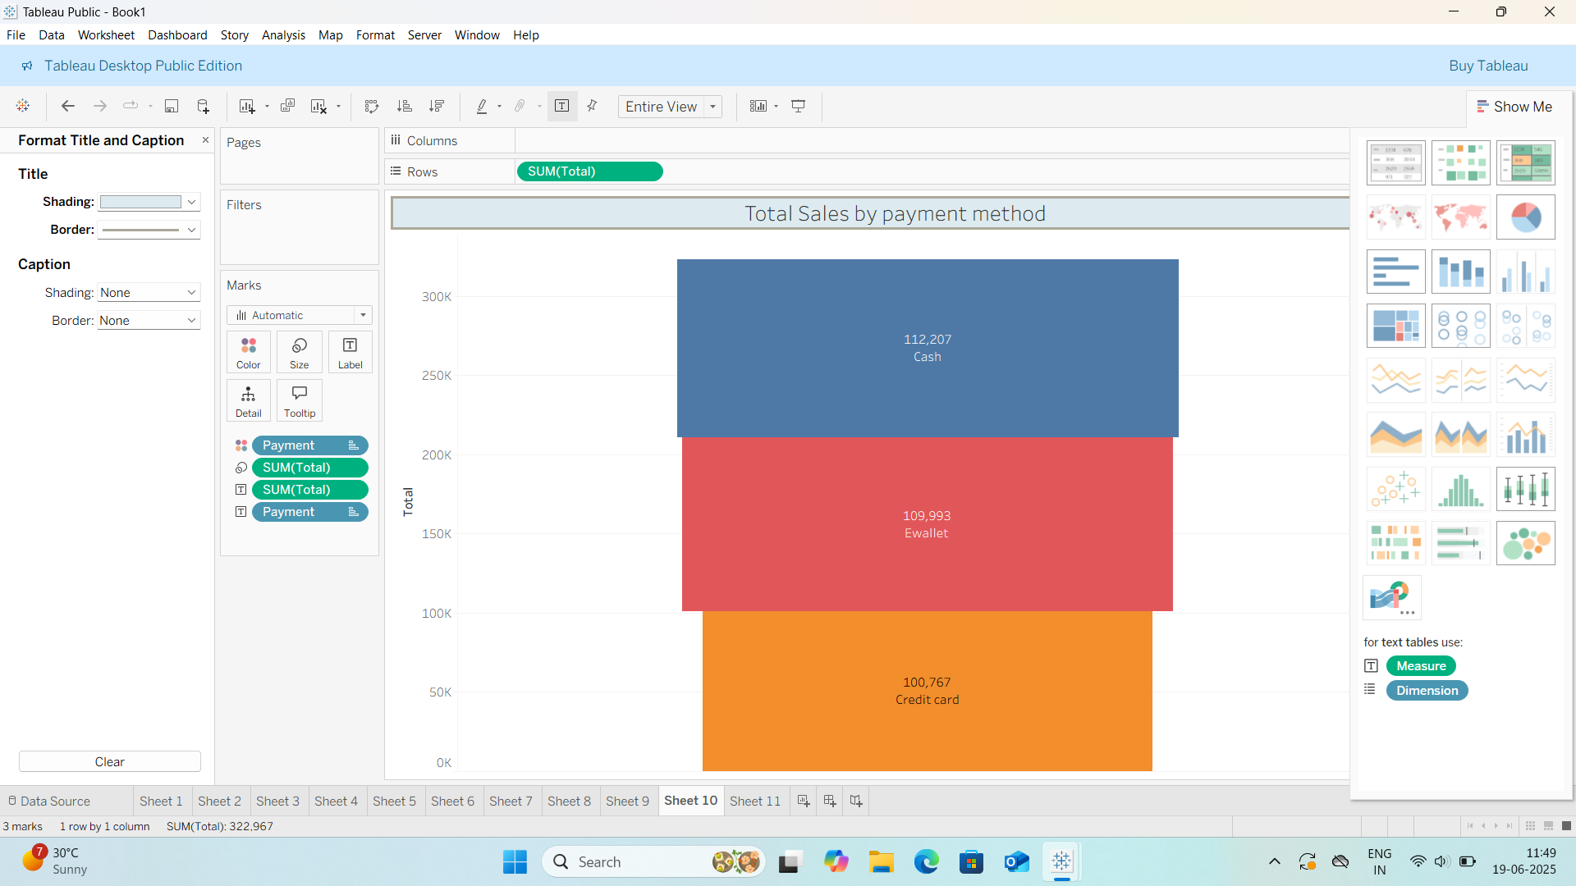
6.Funnel chart:-

Slide 7
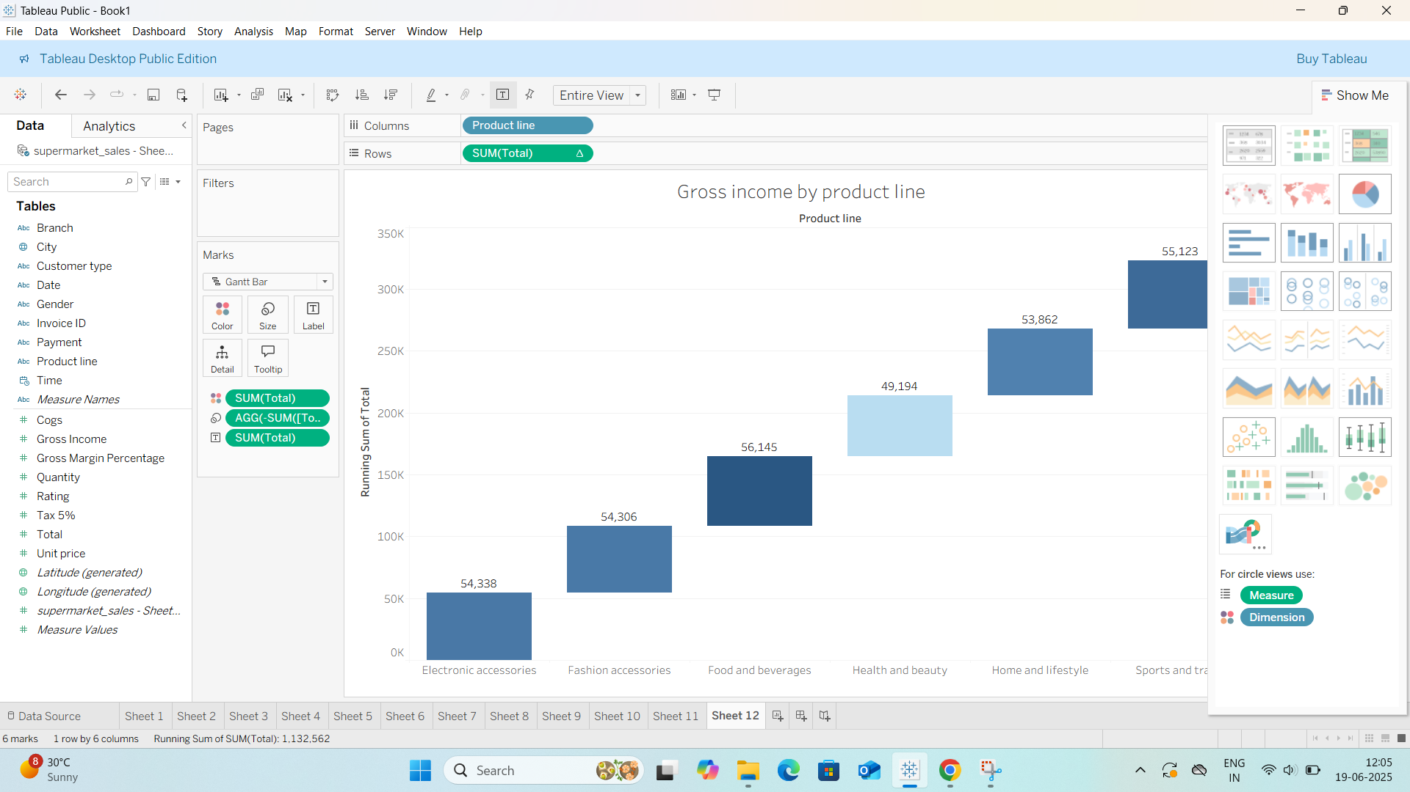
7.Waterfall chart:-

